Slide 1
RANDOM VARIABLES
AND
DISTRIBUTIONS
Dr. Keerthy A S

Slide 2
Random Variables
A random variable is a variable whose value is unknown or a function that assigns values to each of an experiment's outcomes.
  For example, if you roll a die, there are 6 possible outcomes
  S={1,2,3,4,5,6}
  X= Even number -> {2,4,6}
Example: Consider random experiment of tossing a coin twice. Sample space is:
S ={(H,H), (H,T), (T,H), (T,T)}
Define random variable X as the number of heads in the experiment:
X((T,T)) = 0, X((H,T))=1,
X((T,H)) = 1, X((H,H))=2

Slide 3
Probability distributions
If we repeat an experiment many times, we can build up a distribution (table/formula) of the values it can take.
Example : Tossing 3 coins together and noting down the number of heads that appear each time

Slide 4
Types of Random Variables
Discrete random variables have a countable number of outcomes
  Examples: getting a H on tossing a coin, Winning a competitive exam
Continuous random variables have an infinite continuum of possible values.
  Examples: blood pressure, weight, the speed of a car, the real numbers from 1 to 6.
Example: Write down the probability distribution for sum of numbers turned up when 2 dice are rolled together

Slide 5
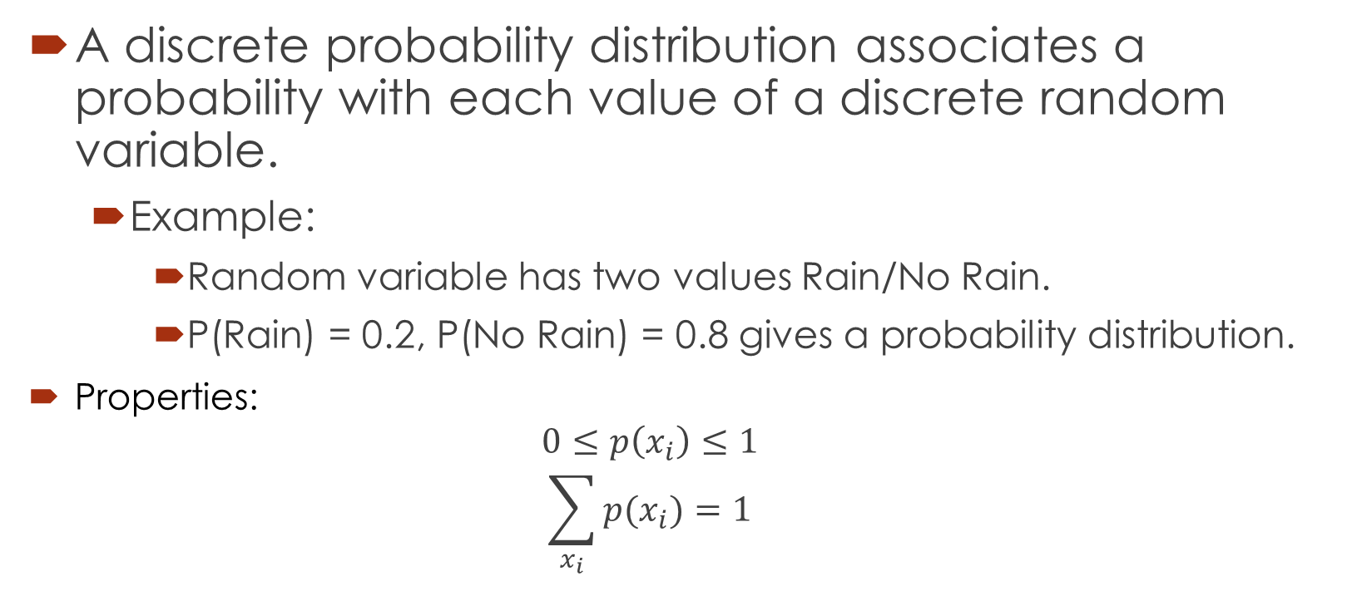
Discrete probability distributions
A discrete probability distribution associates a probability with each value of a discrete random variable.
  Example:
    Random variable has two values Rain/No Rain.
    P(Rain) = 0.2, P(No Rain) = 0.8 gives a probability distribution.
Properties:
  $$0≤p\left(x_{i}\right)≤1$$
  $$\sum_{x_{i}}{p(x_{i})}=1$$
Notes:
Other relevant examples?

Slide 6
The cumulative distribution function (CDF) of random variable X is defined as
F(x)=P(X≤x), for all x∈R.
1. What’s the probability that you roll a 3 or less in a single dice?
2. What’s the probability that you roll a 5 or higher?

Slide 7
Probability Mass Function
Probability mass function (pmf) is a statistical expression that defines a probability distribution (the likelihood of an outcome) for a discrete random variable
a. f(x)=.25 for x=9,10,11,12

Slide 8
b. f(x)= (3-x)/2 for x=1,2,3,4 c. f(x)= (x²+x+1)/25 for x=0,1,2,3

Slide 9
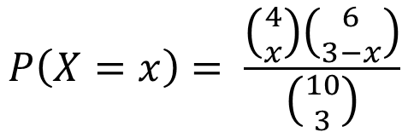
An urn contains 6 red and 4 white balls. Three balls are drawn at random. Obtain the probability distribution of the number of white balls drawn.
X | 0 | 1 | 2 | 3
P(x) | 1/6 | ½ | 3/10 | 1/30
$$P\left(X=x\right)= \frac{\left({4 \atop x}\right)\left({6 \atop 3−x}\right)}{\left({10 \atop 3}\right)}$$

Slide 10
A random variable X has the following probability function:
x | 0 | 1 | 2 | 3 | 4 | 5 | 6 | 7
P(x) | 0 | k | 2k | 2k | 3k | k² | 2k² | 7k² + k
Find k
Evaluate p(x>6)
Evaluate P(x< 6)
Evaluate P(0<x<5)

Slide 11
Continuous Random Variable
A continuous random variable is one which can take any value in some range.
  Example : crop yield, maximum temperature
Since continuous random variables can take all values in a range, it is not possible to assign probabilities to individual values.
We have a continuous curve, called a probability density function, which allows us to calculate the probability as a value within any interval.
This probability is calculated as the area under the curve between the values of interest.
The total area under the curve must equal 1.

Slide 12
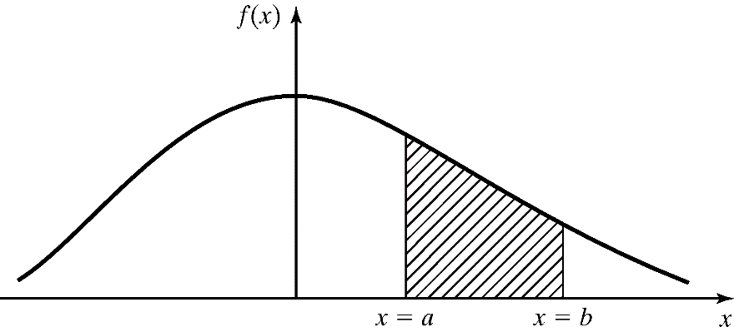

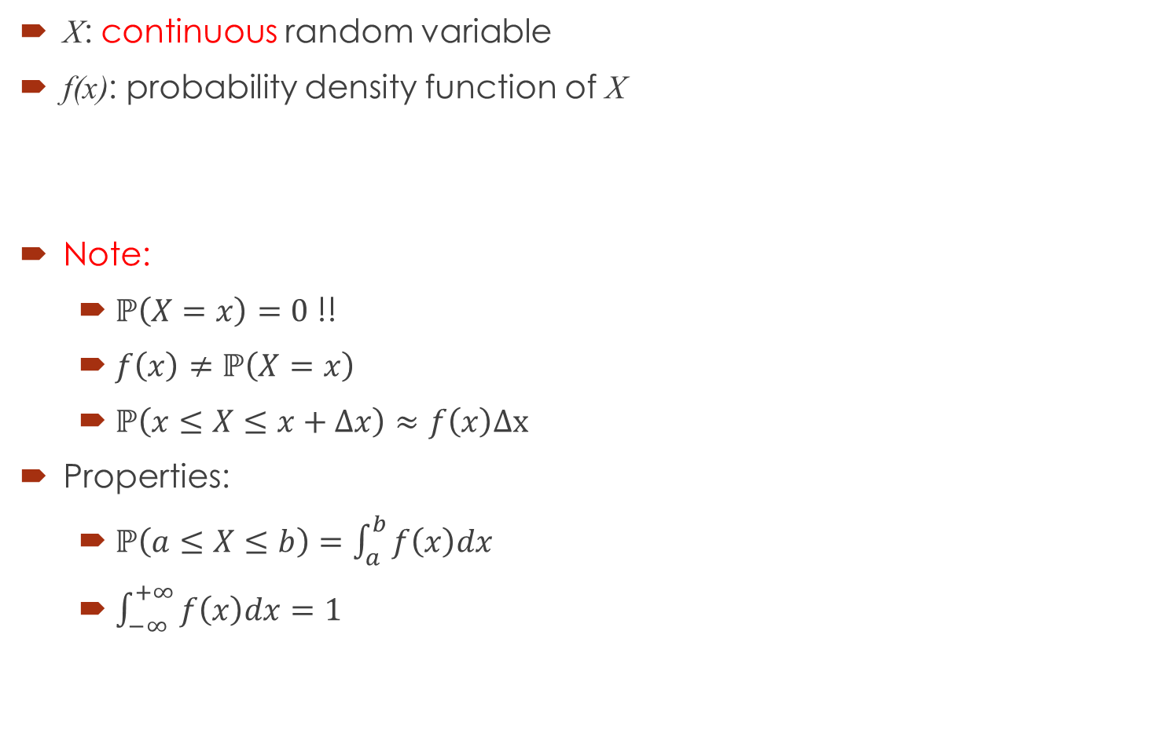
Probability Density Function (PDF)
X: continuous random variable
f(x): probability density function of X
Note:
  $ℙ\left(X=x\right)=0$ !!
  $f\left(x\right)≠ℙ\left(X=x\right)$
  $ℙ\left(x≤X≤x+Δx\right)≈f\left(x\right)Δx$
Properties:
  $ℙ\left(a≤X≤b\right)=\int_{a}^{b}{f\left(x\right)dx}$
  $\int_{−∞}^{+∞}{f\left(x\right)dx}=1$
CDF of $X$

Slide 13
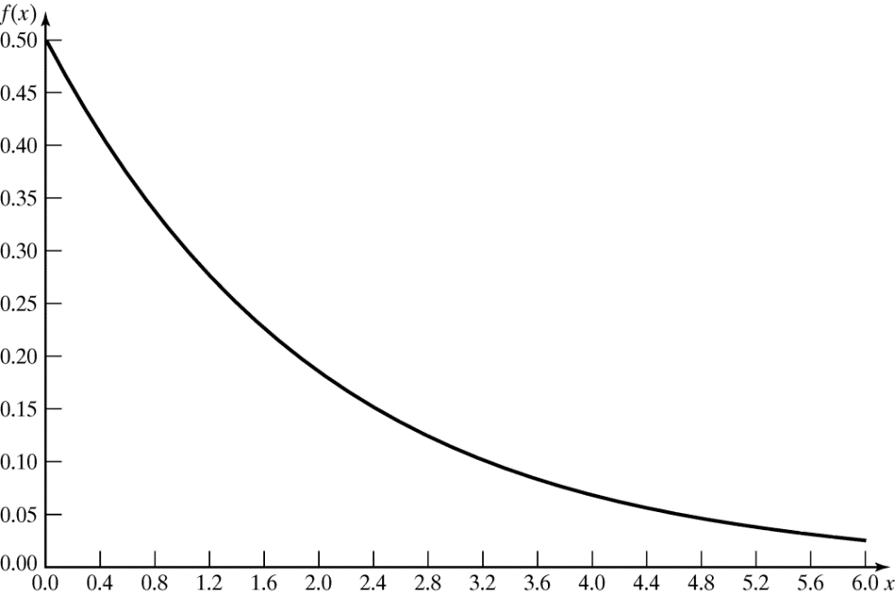

Probability Density Function
Example: Life of an inspection device is given by $X$, a continuous random variable with PDF:
$f\left(x\right)=\frac{1}{2}e^{−\frac{x}{2}}$, for $x≥0$
  Probability that the device’s life is between 2 and 3 years:
  $$ℙ\left(2≤X≤3\right)=\frac{1}{2}\int_{2}^{3}{e^{−\frac{x}{2}}dx=0.14}$$

Slide 14
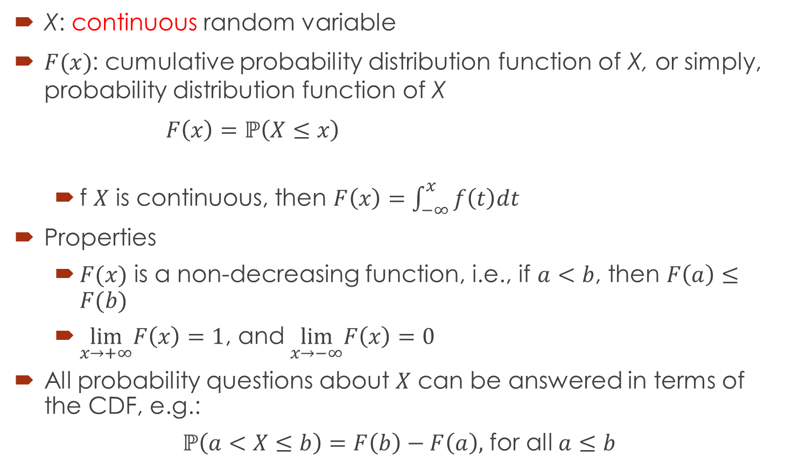
Cumulative Distribution Function (CDF)
X: continuous random variable
$F(x)$: cumulative probability distribution function of X, or simply, probability distribution function of X
$F\left(x\right)=ℙ\left(X≤x\right)$
  f $X$ is continuous, then $F\left(x\right)=\int_{−∞}^{x}{f\left(t\right)dt }$
Properties
  $F(x)$ is a non-decreasing function, i.e., if $a<b$, then $F\left(a\right)≤F(b)$
  $\lim_{x→+∞}F\left(x\right)=1$, and$\lim_{x→−∞}F\left(x\right)=0$
All probability questions about $X$ can be answered in terms of the CDF, e.g.:
$ℙ\left(a<X≤b\right)=F\left(b\right)−F\left(a\right),$ for all $a≤b$

Slide 15
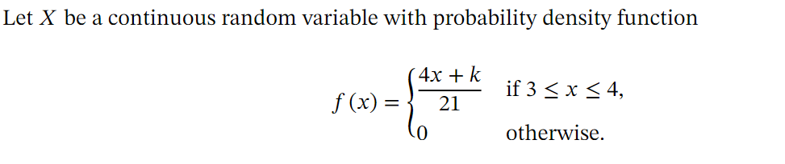


Slide 16
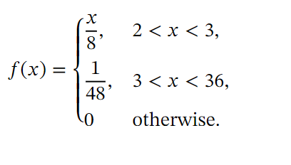
Let 𝑋 be a continuous random variable with the probability density function
Find 𝑃(11≤ 𝑥 ≤24).

Slide 17
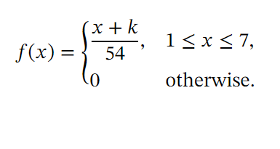
Let 𝑋 be a continuous random variable with probability density function
Find 𝑃(𝑋>4)

Slide 18
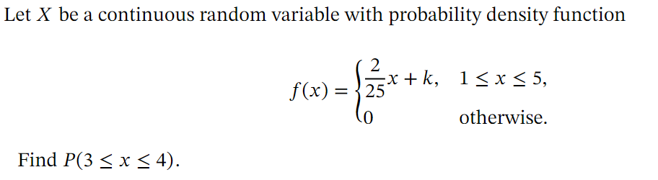

Slide 19
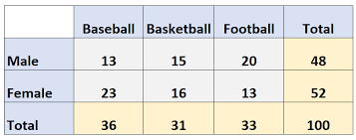

Slide 20
Joint probability density function of Discrete Random Variable:
if we have two random variables X and Y, and we would like to study them jointly, we define the joint probability mass function as follows:
p(x,y) = P[X = x, Y = y]

Slide 21
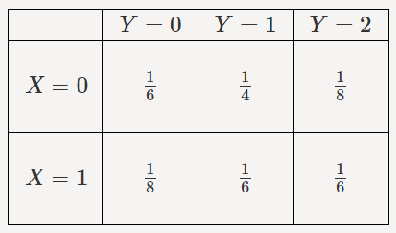
Consider two random variables X and Y with joint PMF given
Find P(X=0,Y≤1).
Find the marginal PMFs of X and Y.
Find P(Y=1|X=0).
Are X and Y independent?

Slide 22
Find P(X=-1,Y≤4).
Find the marginal PMFs of X and Y.
Find P(Y=1|X=2).
Are X and Y independent?

Slide 23
Marginal Density Function
Let X and Y denote two discrete random variables with joint probability function
p(x,y) = P[X = x, Y = y]
Then
p_{X}(x) = P[X = x] is called the marginal probability function of X.
and
p_{Y}(y) = P[Y = y] is called the marginal probability function of Y.

Slide 24
Conditional Density Function
Let X and Y denote two discrete random variables with joint probability function
p(x,y) = P[X = x, Y = y]
Then
p_{X |Y}(x|y) = P[X = x|Y = y] is called the conditional probability function of X given Y = y
and
p_{Y |X}(y|x) = P[Y = y|X = x] is called the conditional probability function of Y given X = x

Slide 25
Consider the following joint discrete probability mass function (pmf):
p(x,y) = 0.1 for (x, y) = (1, 1), (2, 1), (1, 2), and (2, 2)
p(x,y) = 0.2 for (x, y) = (0, 0)
p(x,y) = 0.4 for (x, y) = (3, 3)
Obtain conditional pmf of X when Y = 1.

Slide 26
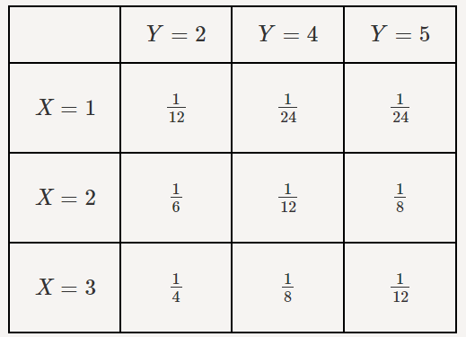
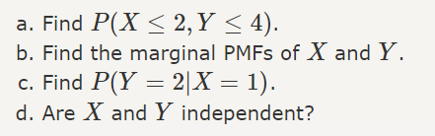
Consider two random variables X and Y with joint PMF given

Slide 27
Joint probability density function of Continuous Random Variable:
Two random variable are said to have joint probability density function f(x,y) if

Slide 28
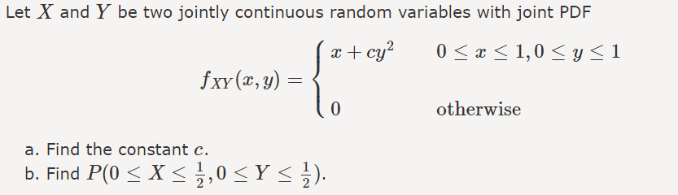

Slide 29
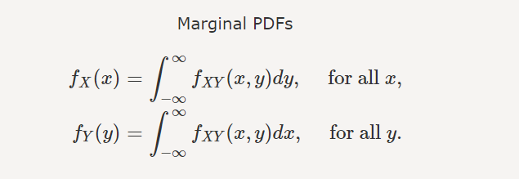

Slide 30
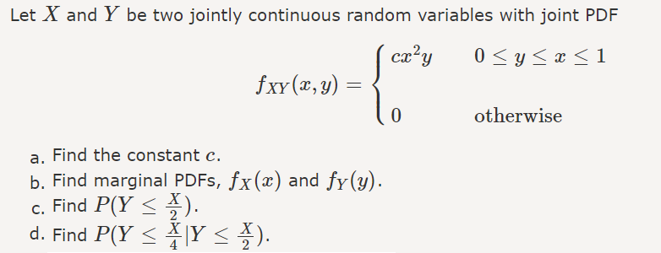

Slide 32



Independent Random Variables:

Slide 33

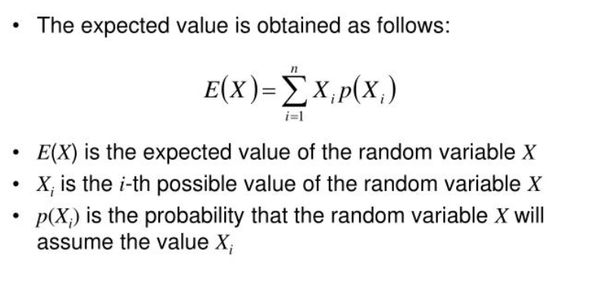
Expected Value and Variance
The expected value (or mean) of X, where X is a discrete random variable, is a weighted average of the possible values that X can take, each value being weighted according to the probability of that event occurring.
E(X)
Expected value represents the long-run average outcome of the random experiment

Slide 34
Let an experiment consist of tossing a fair coin three times. Let X denote the number of heads which appear. Then the possible values of X are 0,1,2 and 3. The corresponding probabilities are 1/8,3/8,3/8, and 1/8. Find the expected value of X.

Slide 35
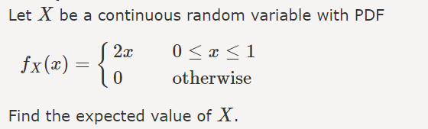

Slide 36
A random variable X has the following probability distribution. Compute expectation of X
X | -1 | 0 | 1 | 2
P(x) | 1/3 | 1/6 | 1/6 | 1/3

Slide 37

Find the expected value of x.

Slide 38
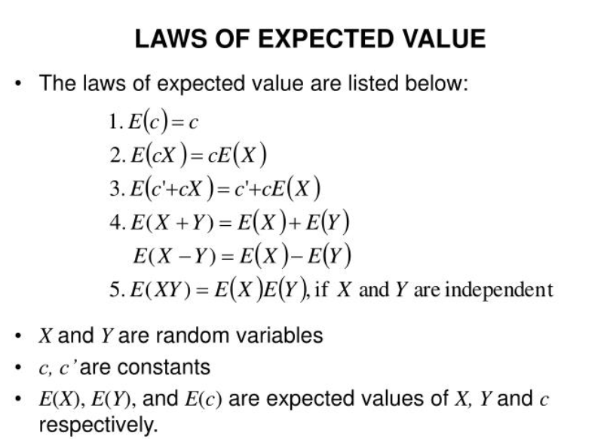

Slide 39


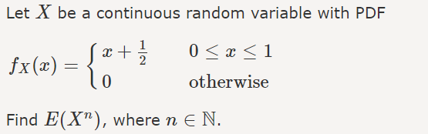
Expected Value of a Function of a Discrete/Continuous Random Variable

Slide 40

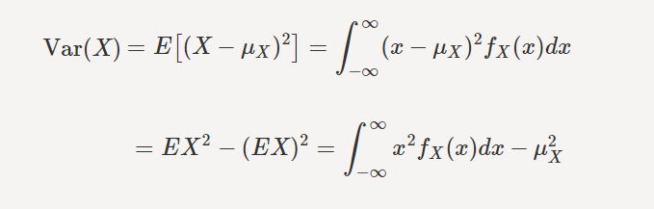
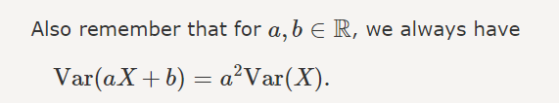
Variance

Slide 41
For the following probability distribution calculate the mean and variance of the random variable x
Also find E(2x+5)
X | 8 | 12 | 16 | 20 | 24
P(x) | 1/8 | 1/6 | 3/8 | ¼ | 1/12

Slide 42

Moments and Moment Generating Functions
The nth moment of a distribution (or set of data) about a number is the expected value of the nth power of the deviations about that number.

Slide 43


Moment Generating Functions
A single expected value function whose derivatives can produce each of the required moments is called a moment generating function
When the nth derivative (with respect to t) of the moment generating function is evaluated at t=0, the nth moment of the random variable X about zero will be obtained

Slide 44
Example – Discrete R V Distribution
Suppose you are given a 3 question multiple-choice test. Each question has 4 responses and only one is correct. Suppose you want to find the probability that you can just guess at the answers and get 2 questions right.

Slide 45

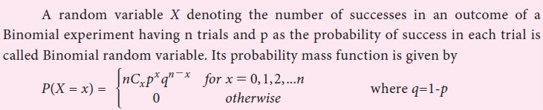
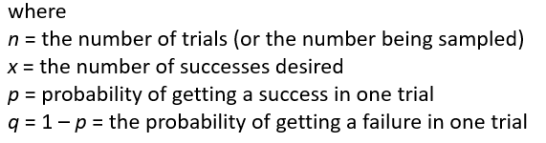
Characteristics of X~B(n,p)

Slide 46
Mean & Variance of X~B(n, p)

Slide 47
QUESTION
Suppose that a central university has to form a committee of 5 members from a list of 20 candidates out of whom 12 are teachers and 8 students. If the members of the committee are selected at random, what is the probability that the majority of committee members are students?

Slide 48
An insurance salesman sells policies to five men, all of identical age and good health. According to the actuarial tables, the probability that a man of this particular age will be alive 30 years hence will be 2/3. Find the probability that in 30 years
(i)all five men
(ii) at least one man
(iii) at least 3 men
(iv)at most 3 men, will be alive.

Slide 49
A student writes a five question multiple-choice quiz. Each question has four possible responses. The student guesses at random for each question. Calculate the probability for each possible score on the test from 0 to 5.

Slide 50
Thirty percent of students at a large university are known to be short-sighted. If twenty students are picked at random, find the probability that at most two of them are shortsighted

Slide 51
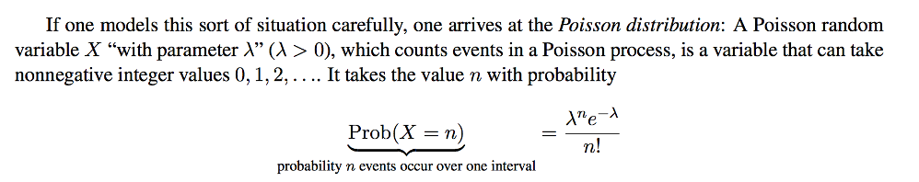

Slide 52
POISSON DISTRIBUTION
This distribution gives the probability of the different possible number of occurrences of an event in a given time interval under certain conditions.
  The events occur independently
  The events occur at random
  The probability of an event occurring in a given time interval does not vary with time
  The mean and variance of Poisson distribution = λ

Slide 53
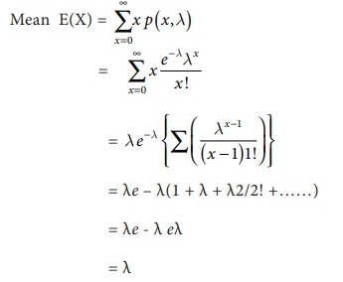
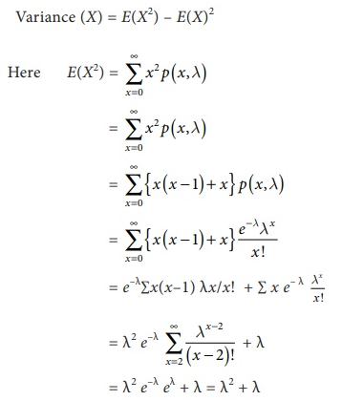
Mean and Variance of Poisson Distribution

Slide 54
Between the hours 2PM and 4 PM , the average number of phone calls per minute coming into the switchboard of a company is 2.35. Find the probability that during one particular minute there will be at most2 phone calls. Given e^{-2.35} = 0.095374

Slide 55
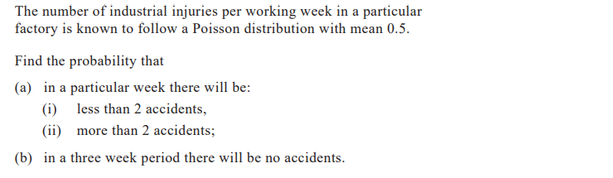

Slide 56
Sheep are randomly scattered in a field which is divided into equal size squares. There are three sheep on average on each square. Determine the probability that on a given square there will be … a)no more than five sheep. b)more than two but no more than seven sheep.

Slide 57
The water from a lake is tested and is found to contain on average three bacteria per litre of water. A sample of 250 ml is collected from the lake. a) Determine the probability that the 250 ml water sample will contain … i. … exactly two bacteria. ii. … at least two bacteria.
A larger sample of two litres of water is collected from the lake. b) Find the probability that this larger sample will contain less than ten but no less than six bacteria.

Slide 58
If 5% of the electric bulbs manufactured by a company are defective, use Poisson distribution to find the probability that in a sample of 100 bulbs
(i) none is defective,
(ii) 5 bulbs are defective.

Slide 59
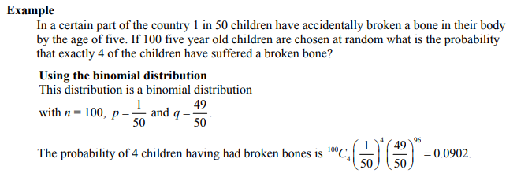
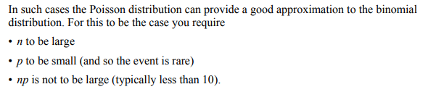

Slide 60
Fit a Poisson distribution and calculate the theoretical frequencies
x | 0 | 1 | 2 | 3 | 4
f | 123 | 59 | 14 | 3 | 1

Slide 61
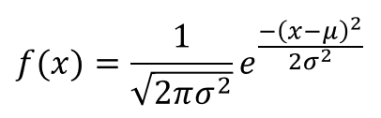
Normal Distribution
X~N(µ, σ)

Slide 62
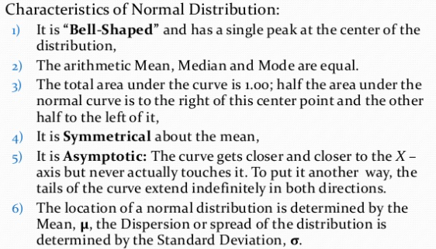

Slide 63
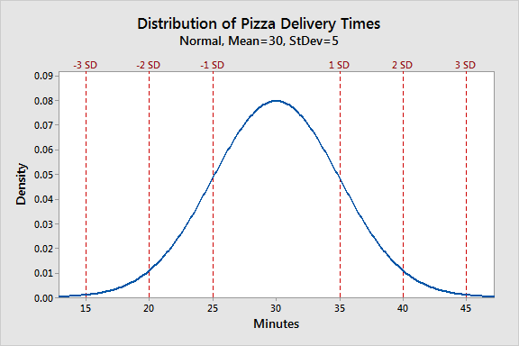
Assume that a pizza restaurant has a mean delivery time of 30 minutes and a standard deviation of 5 minutes.

Slide 64
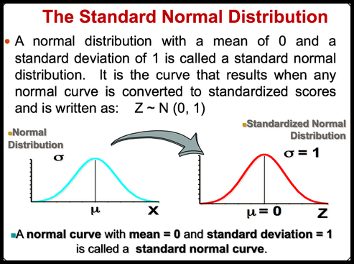

Slide 65
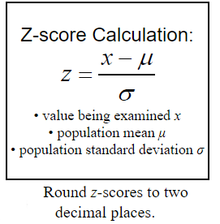
The process of converting a value from a normal distribution to a value for the standard normal distribution is called "standardizing" and requires the use of z-scores.
z-scores tell us how far a value is from the mean

Slide 66
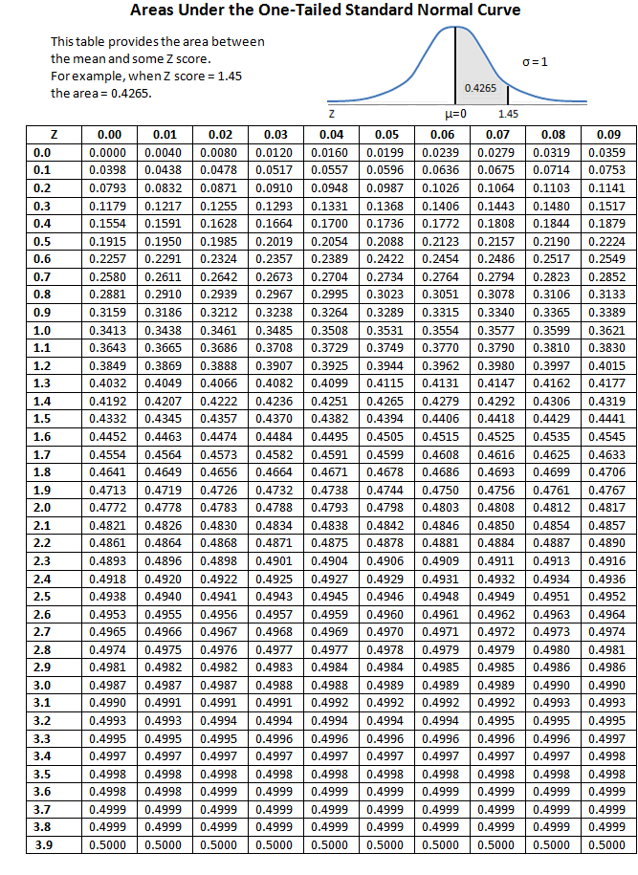
Find P(Z ≤ 1).
Find P(Z ≤ −2).
Find P(Z ≥ 2.5).
Find P(Z ≥ -1.5).

Slide 67
Find P(−2≤ Z ≤ 2).
Find P(−1.5 ≤ Z ≤ 2.5).

Slide 68
Find P(−1.53 ≤ Z ≤ 2.16).

Slide 69
If the length of newborn alligators, X, is normally distributed with mean µ = 6 inches and standard deviation σ = 1.5 inches, what is the probability that an alligator egg about to hatch, will deliver a baby alligator between 4.5 inches and 7.5 inches?

Slide 70
Most graduate schools of business require applicants for admission to take the Graduate Management Admission Council’s GMAT examination. Scores on the GMAT are roughly normally distributed with a mean of 527 and a standard deviation of 112. What is the probability of an individual scoring above 500 on the GMAT?

Slide 71
The average number of acres burned by forest and range fires in a large New Mexico county is 4,300 acres per year, with a standard deviation of 750 acres. The distribution of the number of acres burned is normal.
a)What is the probability that between 2,500 and 4,200 acres will be burned in any given year?
b)What number of burnt acres corresponds to the 38th percentile?

Slide 72
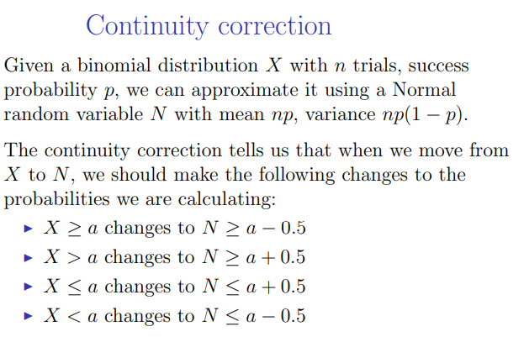
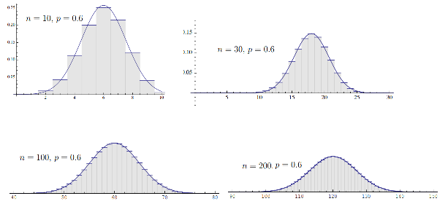
Binomial Approximation to Normal

Slide 73
A normal distribution has 77 as mean. Find its standard deviation if 20% of the area under the curve lies to the right of 90.

Slide 74
A line for tickets to a local concert had an average (mean) waiting time of 20 minutes with a standard deviation of 4 minutes. If 2000 ticket buyers were in line, how many of them would expect to wait for more than 30 minutes?
https://homepage.divms.uiowa.edu/~mbognar/applets/normal.html

Slide 75
The Floppy Disk Company makes 3.5 inch floppy disks for disk drives that are 3.7 inches wide. The width of a manufactures disk is normally distributed with a standard deviation of 0.1 inches. The company manufactures 1000 disks every hour.
a) 30% of the disks’ widths were less than how many inches?
b) 45% of the disks’ widths were wider than how many inches?
c) In one hour, how many disks would you expect to be between 3.45 inches and 3.55 inches?
d) The middle 40% of floppy disks are between which two widths?

